Slide 1

Boston Airbnb feedback analysis
IST664 Group 3
Mengdie Zhuang Chaoying Lyu Ruiwei Zhang Zeyi Luo Renjie Zhu

Slide 2
Content
Project description
Methods
Data preprocessing
Modeling
Business question and conclusion

Slide 3

Project description

Slide 4

Project description
Data：
Airbnb in Boston
Method:
Sentiment analysis on comments and sentences
Target:
Service improvement
Notes:
Since 2008, guests and hosts have used Airbnb to expand on traveling possibilities and present more unique, personalized way of experiencing the world. This dataset describes the listing activity and metrics in Boston.
We are focusing on the following Airbnb activity included in this Boston dataset. Based on the comments of the reviewers, we want to dig deeper on the general feedbacks of each Boston neighborhood and give specific suggestions on the Airbnb services. The sentiment analysis will be done on both the paragraph and the sentence level. We will analyze the whole comment and find out what users pay attention to.

Slide 5
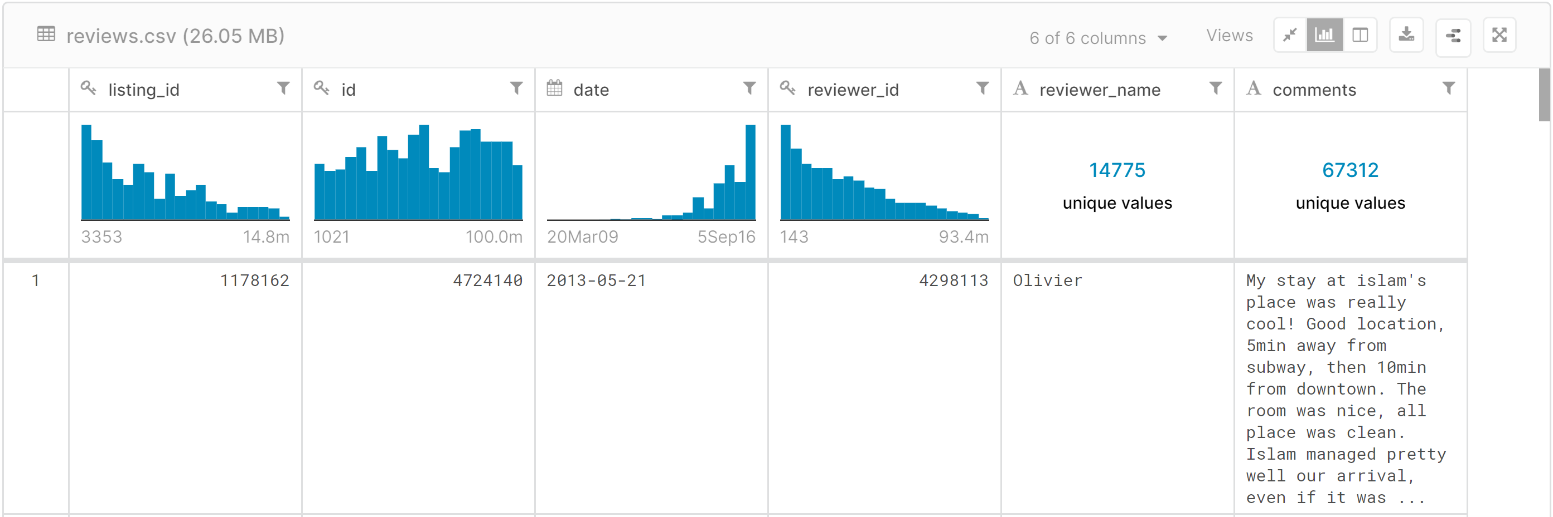
Data introduction
Source: from Kaggle Boston Airbnb Open Data

Slide 6

Method

Slide 7
Method
Sentiment analysis from comment level
Sentiment analysis from sentence level

Slide 8
Data preprocessing

Slide 9
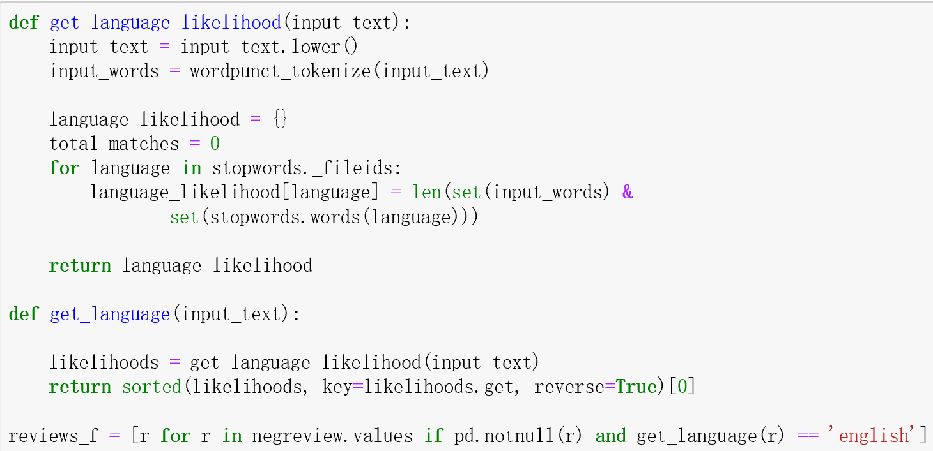
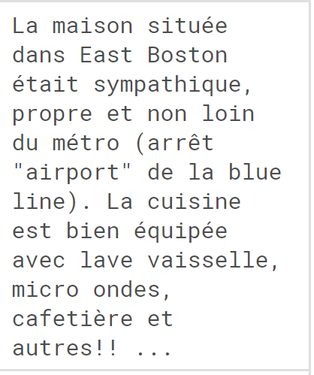
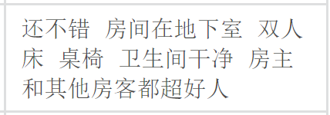
Data preprocessing
Extract review data
lowercase all the words
NA removement
Tokenization
Language detection
Remove all the numbers, the characters that are not alphabetical, the stop words, words whose lengths are less than 3
stemming
lemmatizing

Slide 10
Modeling

Slide 11
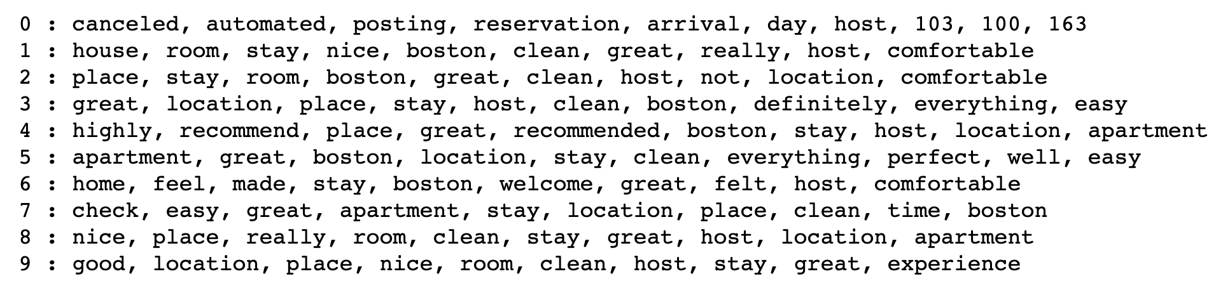
K-means Clustering
Remove Stopwords
Tokenized
TF-IDF vectorize
Set up k-means
K-means clustering is a data mining method used to group similar data points together and discover underlying patterns.
Workflow:
Result:
Clean location comfortable
Notes:
We could see that in the first cluster, time could be the topic. And In the second and third cluster, comfortable and room may be the key word. And there are many replicate word, like clean,

Slide 12
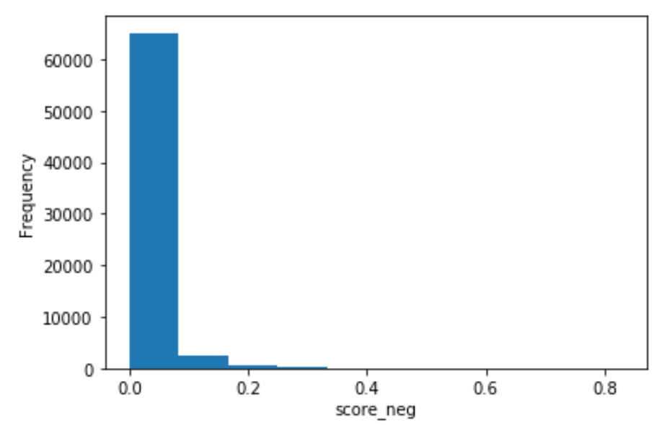
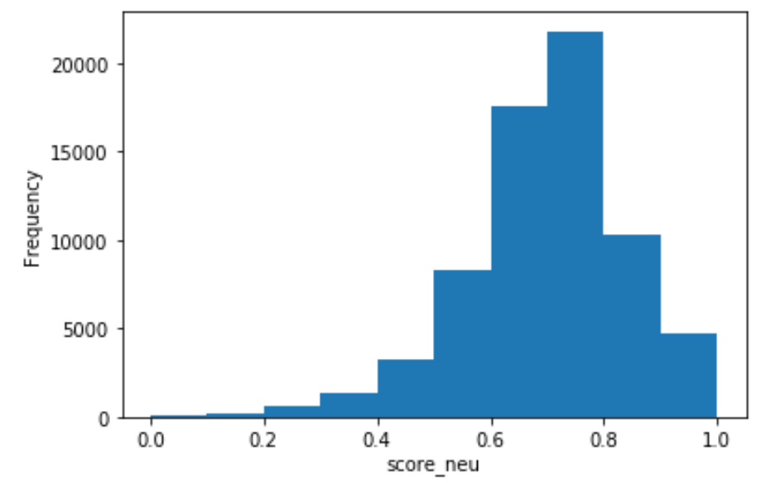
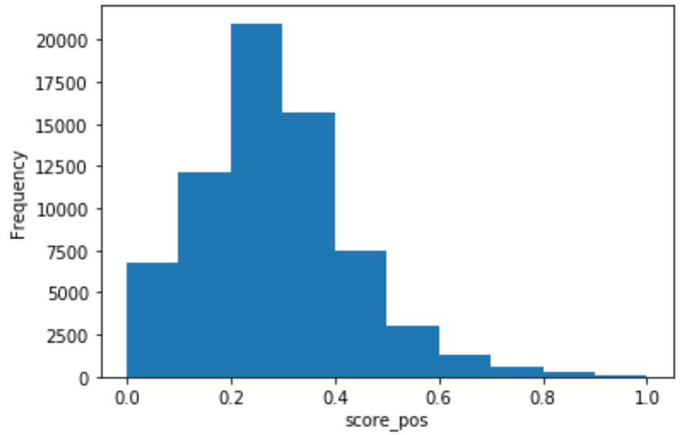
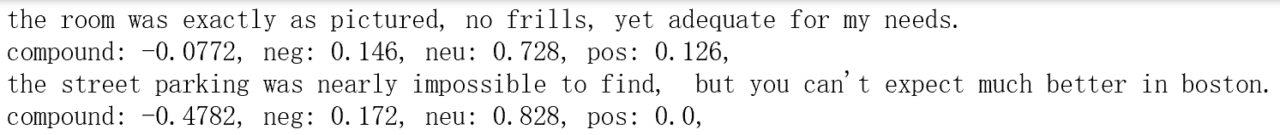
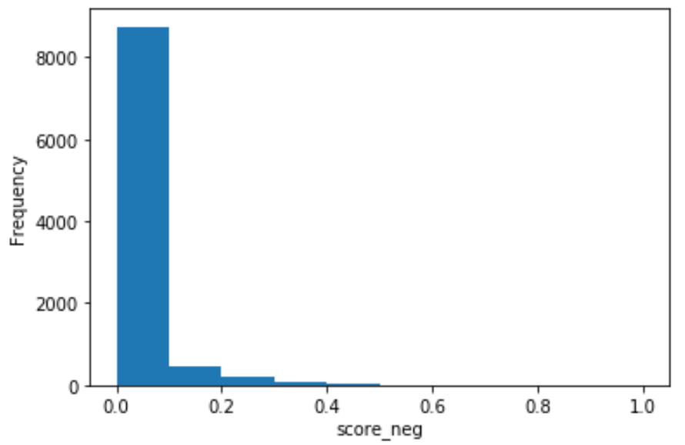
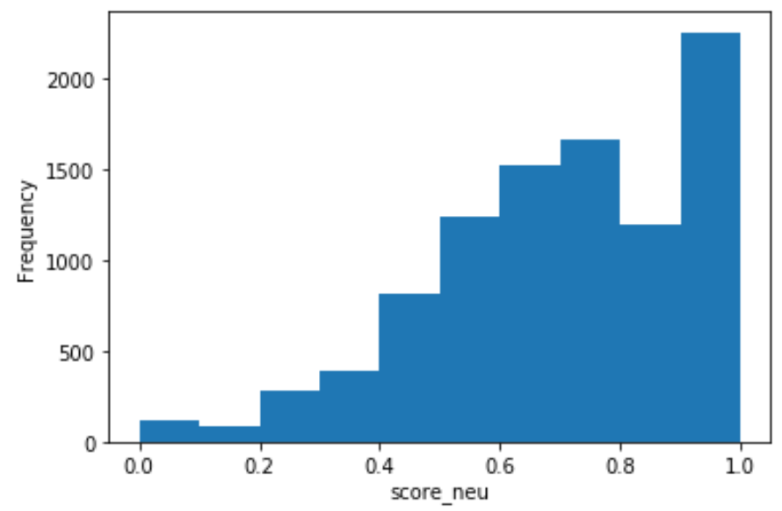
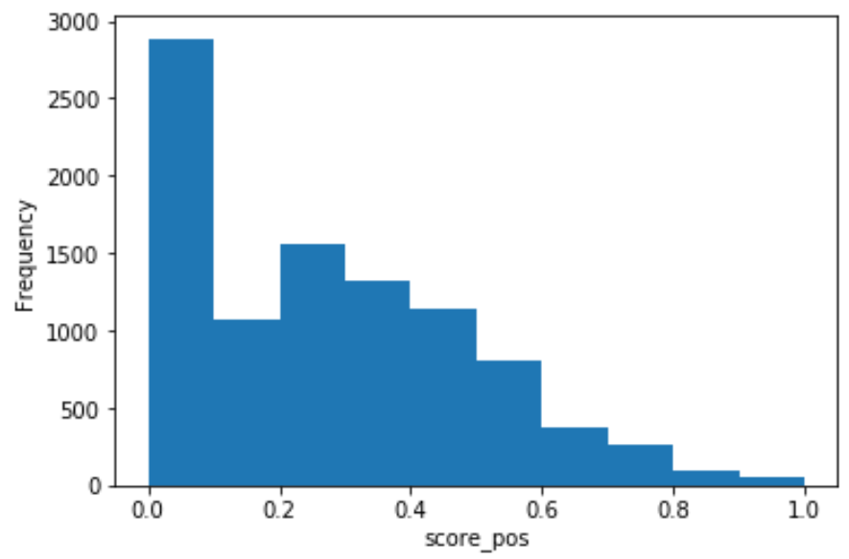
Sentiment Polarity for Reviews--Bigram
Comment level
Sentence level

Slide 13
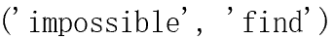
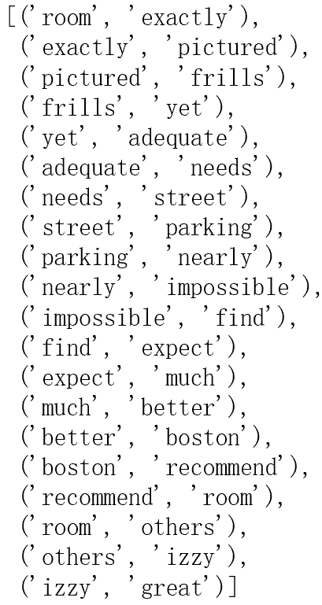
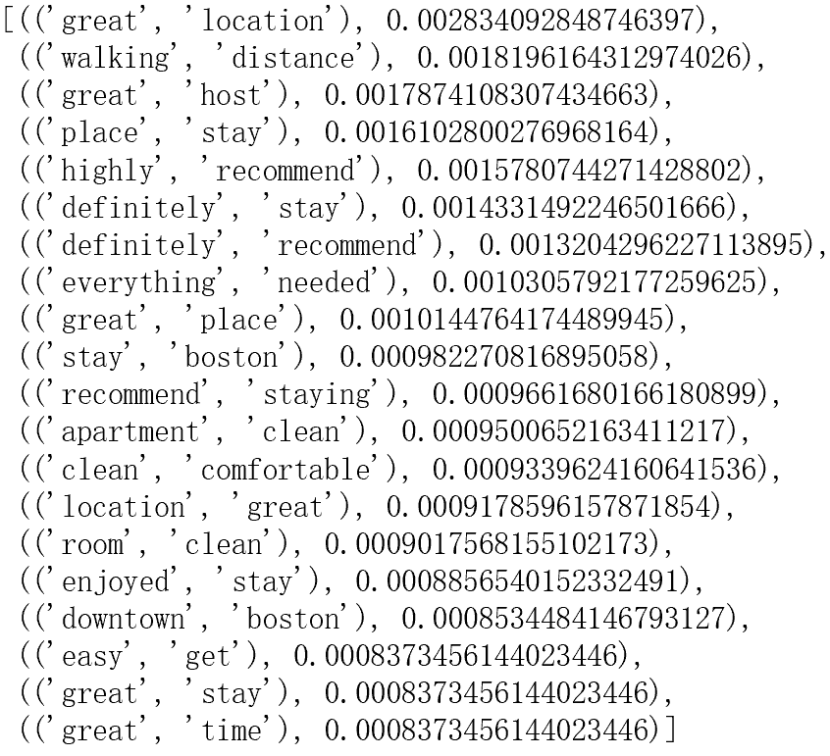
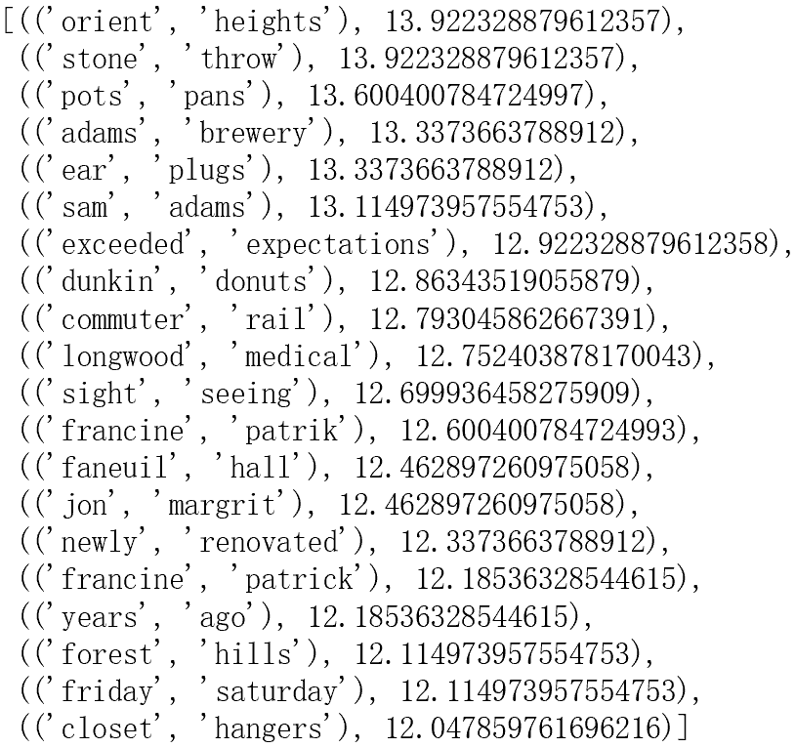
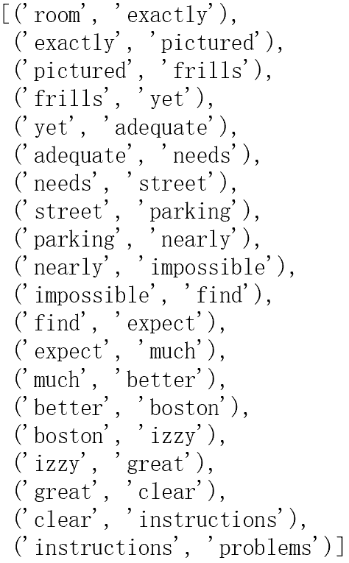
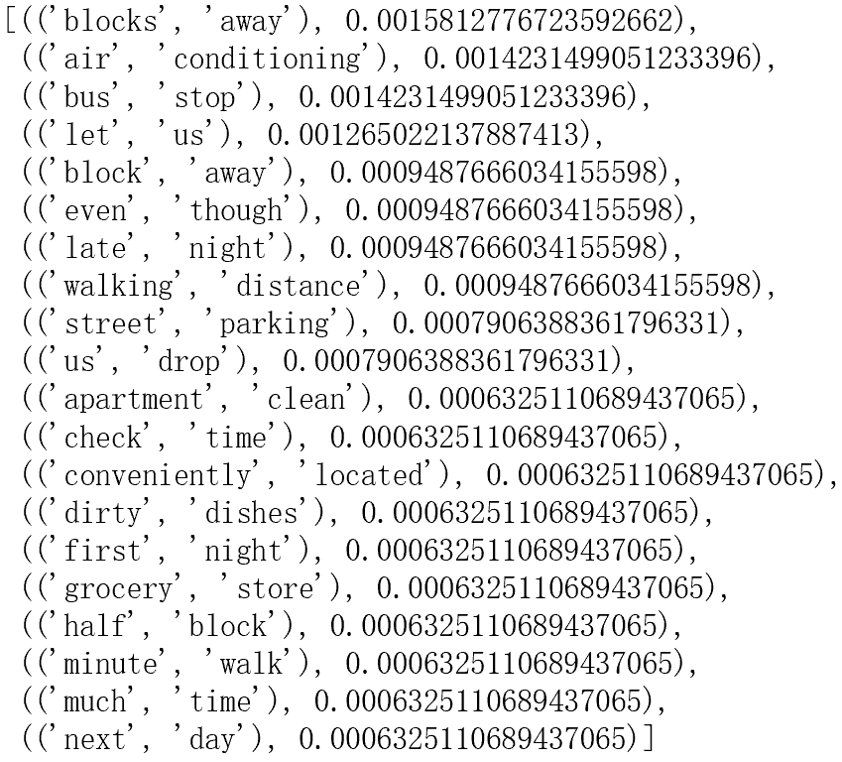
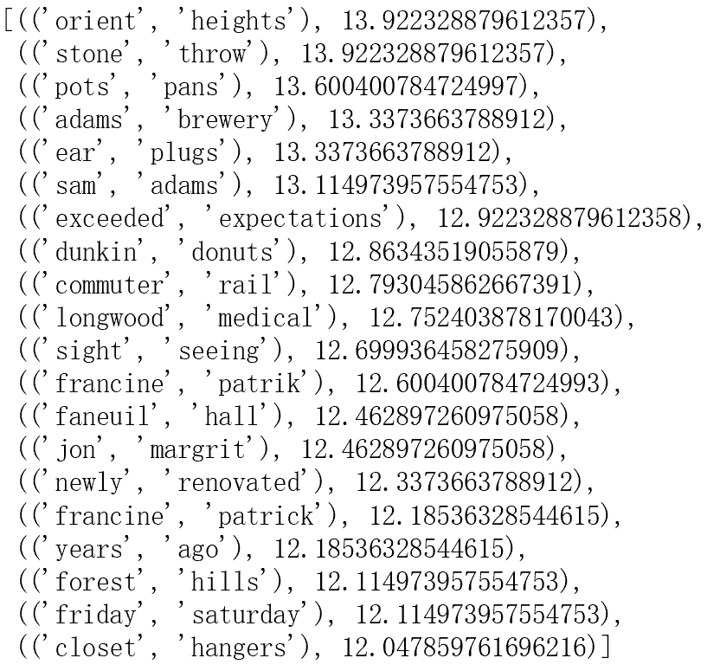
Sentiment Polarity for Reviews--Bigram
Comment level
Ear plugs
Commuter rail
Newly renovated
Closet hangers
Bigram bigram_measures.raw_freq bigram_measures.pmi
Sentence level
Air conditioning
Bus stop
Street parking
Apartment clean
Check time
Grocery store
Ear plugs
Commuter rail
Newly renovated
Closet hangers

Slide 14
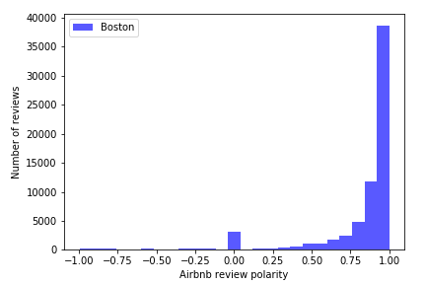
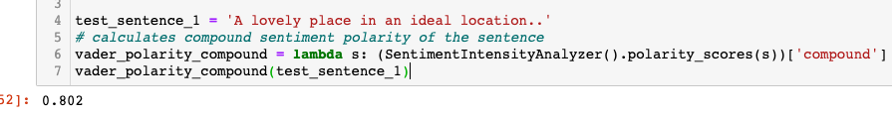
Sentiment Polarity for Reviews
Polarity histogram for Airbnb reviews

Slide 15
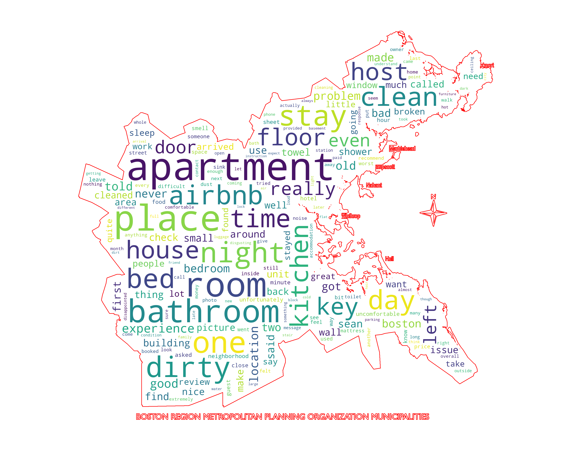
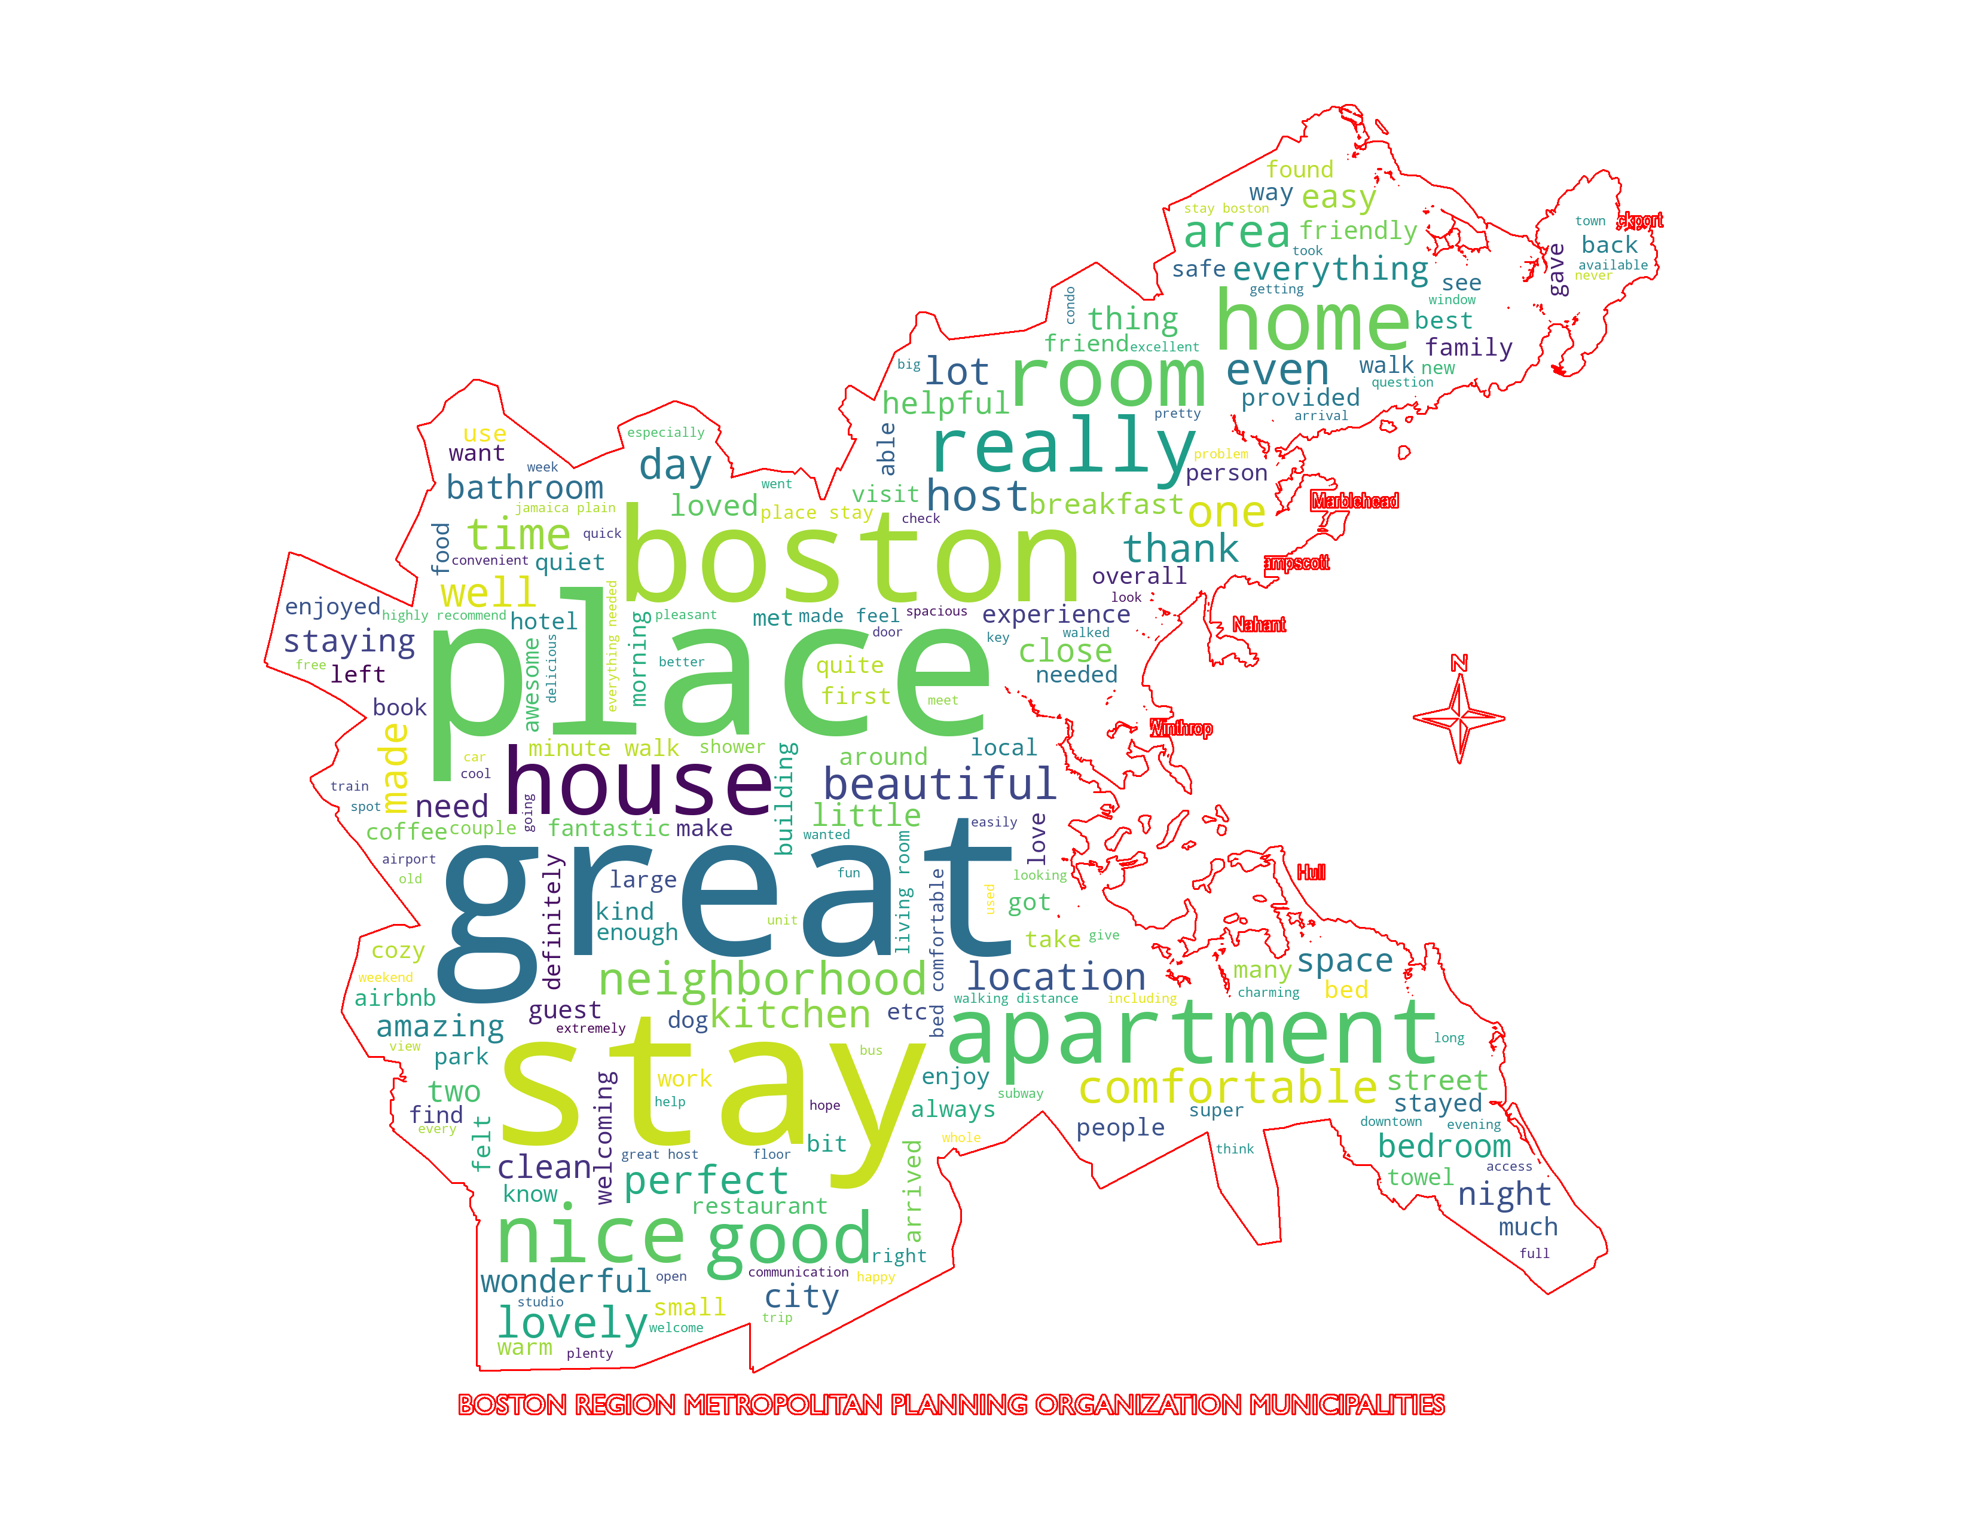
Two Extreme Datasets
Very negative reviews
Very positive review

Slide 16
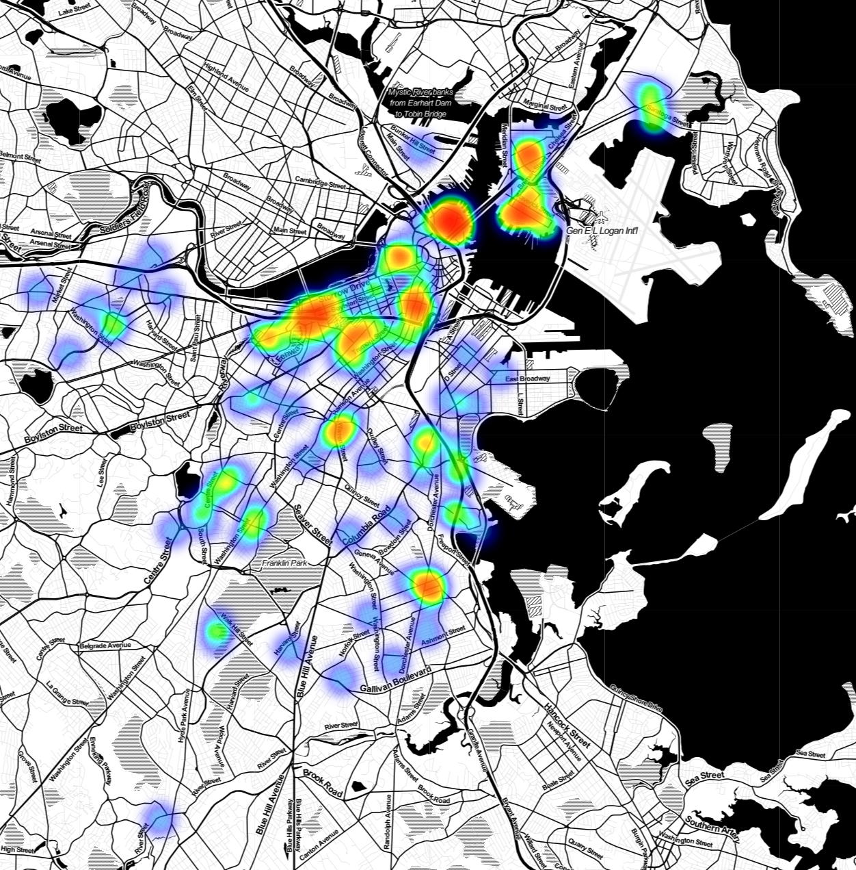
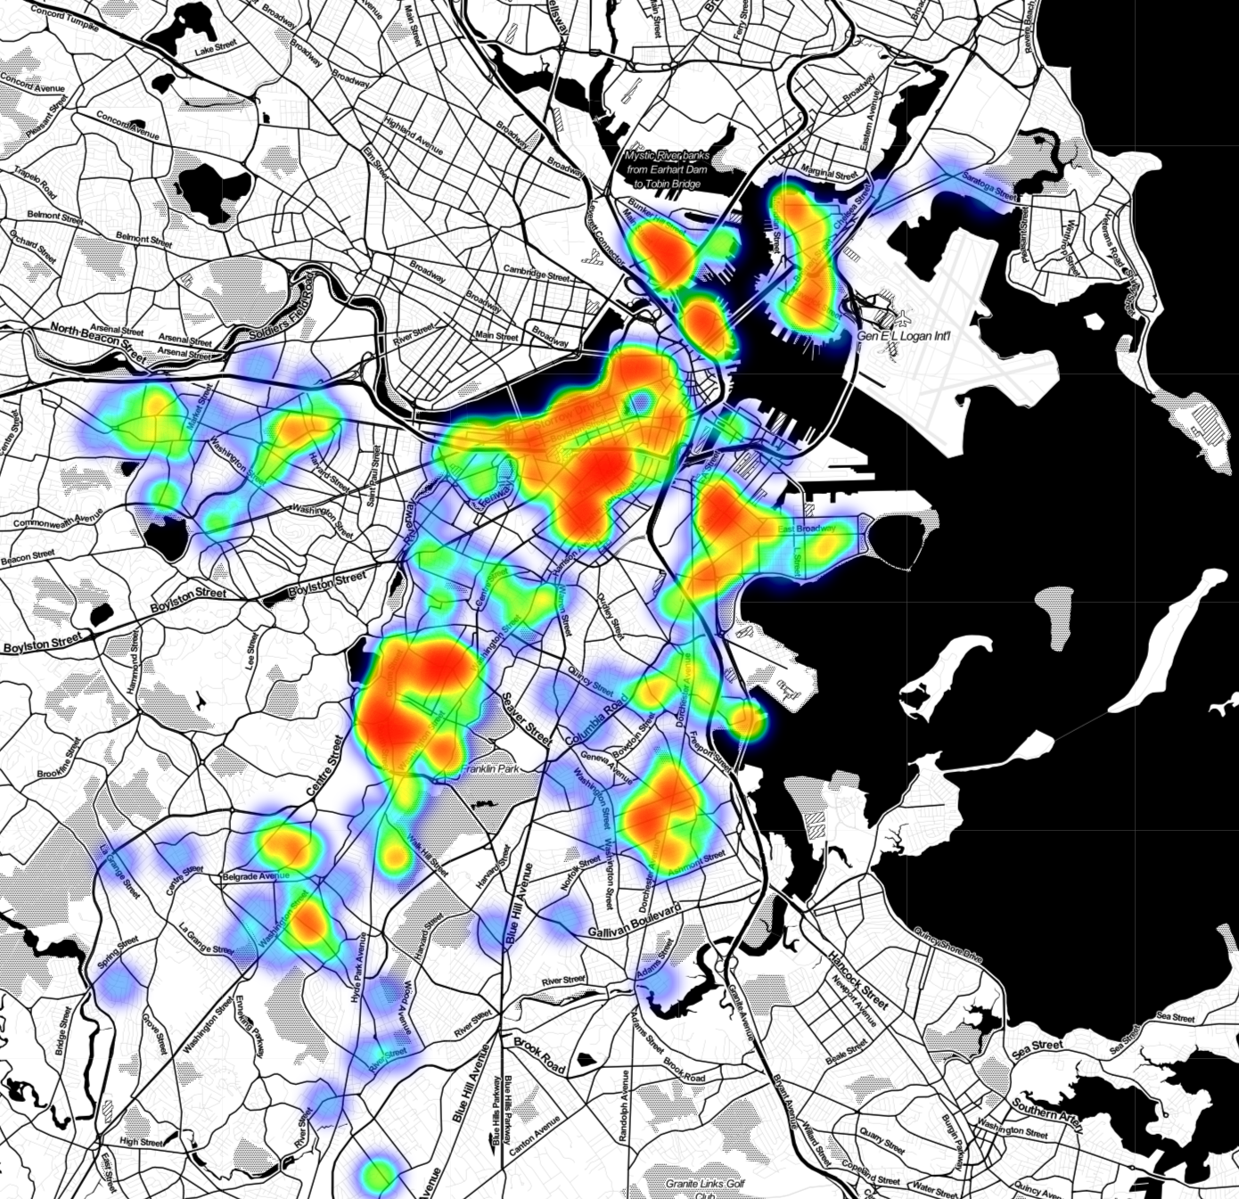

Two Extreme Datasets
Very negative reviews location
Very positive review location

Slide 17
Topic Modeling
Latent Dirichlet allocation (LDA)
7 topics of Extreme Datasets
Notes:
is a generative statistical model that allows sets of observations to be explained by unobserved groups that explain why some parts of the data are similar.

Slide 18
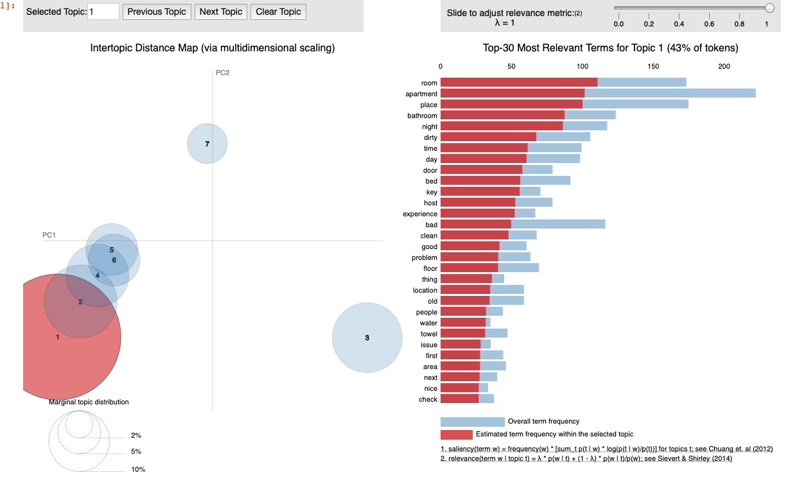
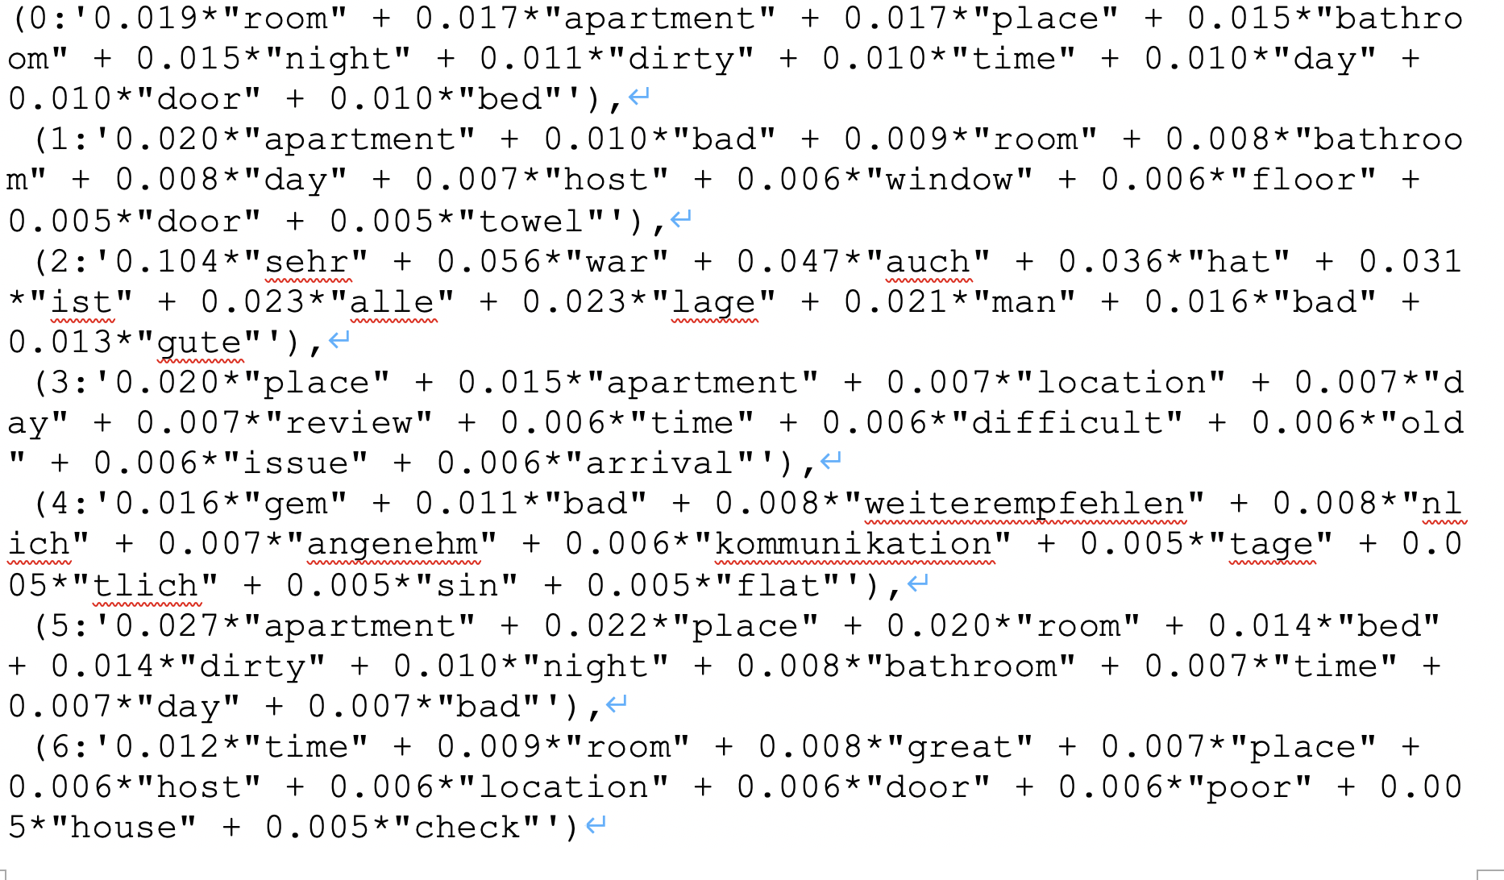
Negative topics

Slide 19
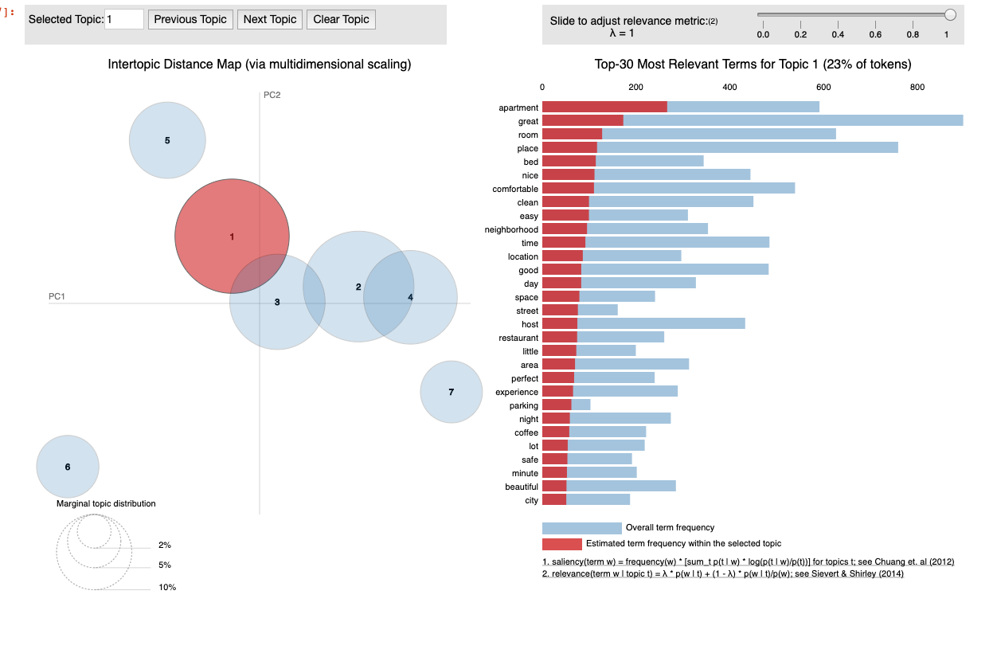
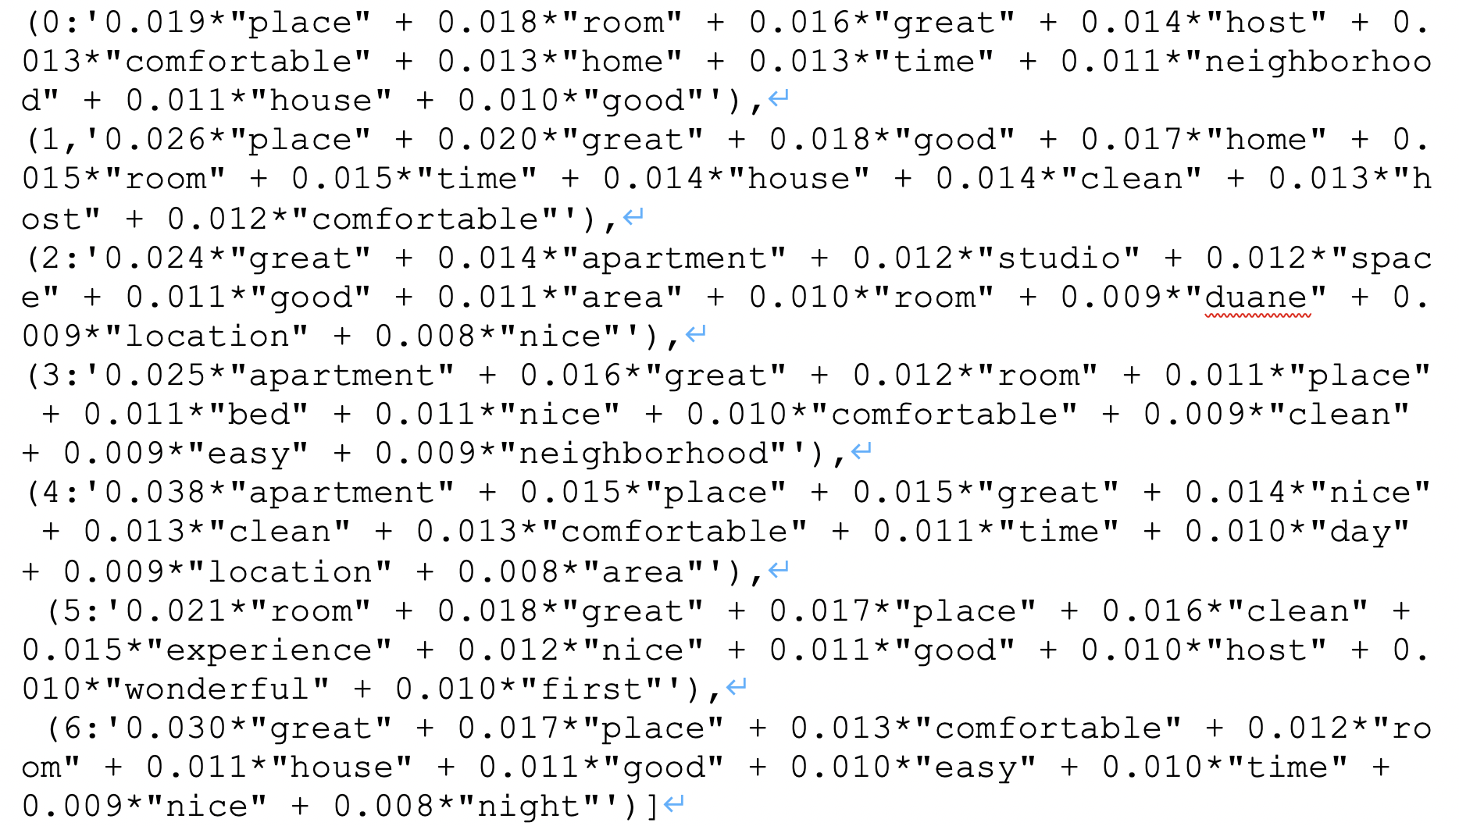
Positive topics

Slide 20
Model Summary
K-means
Classifying words into different groups, getting word frequency, helping other model to get more insights.
Disadvantage: no tagging for reviews, no clear classification based on sentiment.
Vader sentiment model
Focusing on negative comments and sentences after tagging sentiment polarity, calculating bigram frequency
Disadvantage: In comments level, lots of positive words show up in negative comments. In sentence level, the model extracts noun words without clear sentiment polarity.
LDA(Latent Dirichlet Allocation) model
Tagging positive and negative words, extracting topics and key words from each review.
Disadvantage: the data in negative topic and positive topic are not very adequate, which may affect the accuracy of topic extraction.
Notes:
So we built three models to analyze reviews.

Slide 21
Business question and conclusion

Slide 22
Business question and conclusion
What are the major factors that affect customers’ satisfaction?
Cleanliness: bathroom; room,
Facility: comfortable
Location : convenient; near to public transportation, grocery store
Service: great host; feel at home
Notes:
The purpose of our model is to find out what are the major factors that affect customers' satisfaction. After comparing all the results we got from different models, we can summarize those factors. First, cleanliness. Customers really care about if the room, bathroom, the sheet on the bed is clean or not. It is very important factor for them to rating a house or apartment. Second, facility, like bed is comfortable, the kitcken is well equipped, etc. Third, location. The house near to public transportation and grocery store are always very popular. Because customers can easy travel to other place for their trip and they can buy necessary supplies nearby.
The last one is about service. Lots of comments mentioned about great host , feel at home. So we think the service provide by host, or the attitude of host may be a significant factor. A nice host will leave great impression to customers.

Slide 23
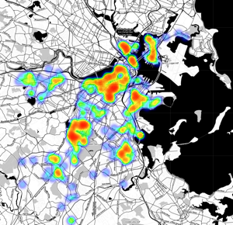
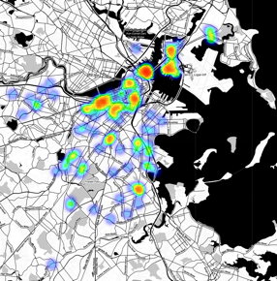
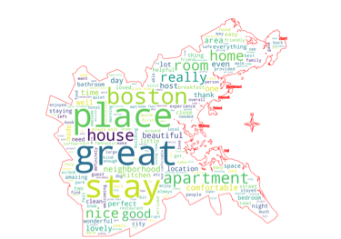
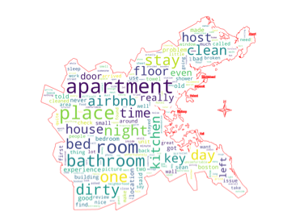
 | Very negative reviews | Very positive reviews
Location
Word

Slide 24
Thank you for watching
Q & A

